Slide 1
Developing a Data-Driven Marketing Tool Using Airbnb Data
Cheromaine Smith, Christine Kwan, Yesul Song

Slide 2
Introduction
The tourism industry, valued at $1.9 trillion in the US alone, has led to the rise of Airbnb, now a $93 billion company.
Data science is being used to create a tool that helps hosts price their rentals and assists guests in finding the perfect accommodation.
Airbnb Start
$1,986 -> $7,936
Through analysis techniques like regression and decision trees, trends are identified to inform travel decisions.

Slide 3
Data Overview
Consisted of three (3) different datasets:
Calendar
Listings
reviews.
These datasets provide a wide overview of the Airbnb business from listing ids and rental descriptions to numbers of bedrooms and bathrooms, with a bit of owner review ratings mixed in.
This compilation of historical data allows for in-depth analysis of owner ratings, rental features, and the possible impact of various factors on the tourism industry.

Slide 4
Data Pre-processing and Cleanup
Remove all the unnecessary variables,like the URL
Formatting all price related columns, zip codes, bedrooms and bathrooms to numeric
Missing values that were in specific text columns were filled in with empty strings

Slide 5
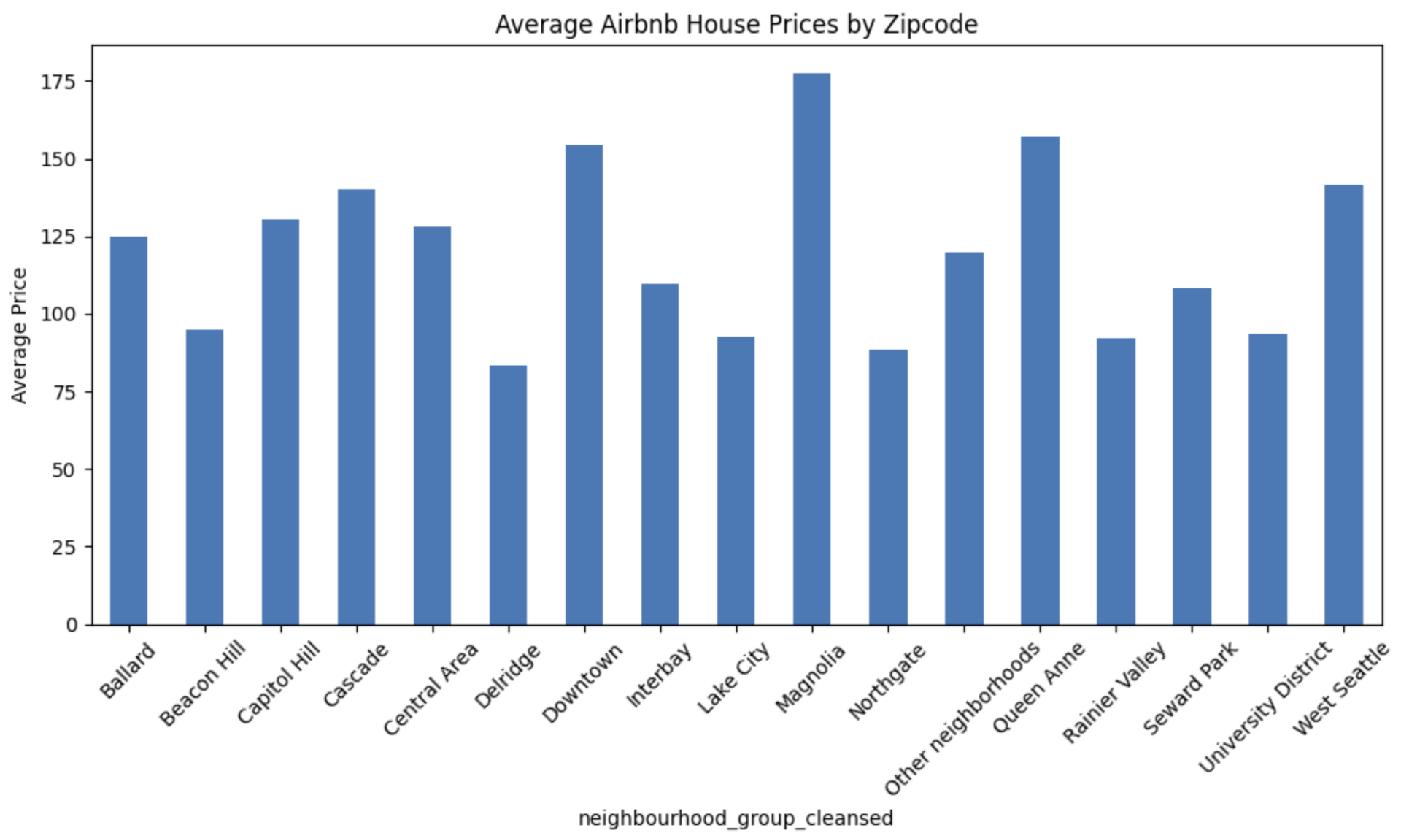
Exploratory Data Analysis (EDA)

Slide 6
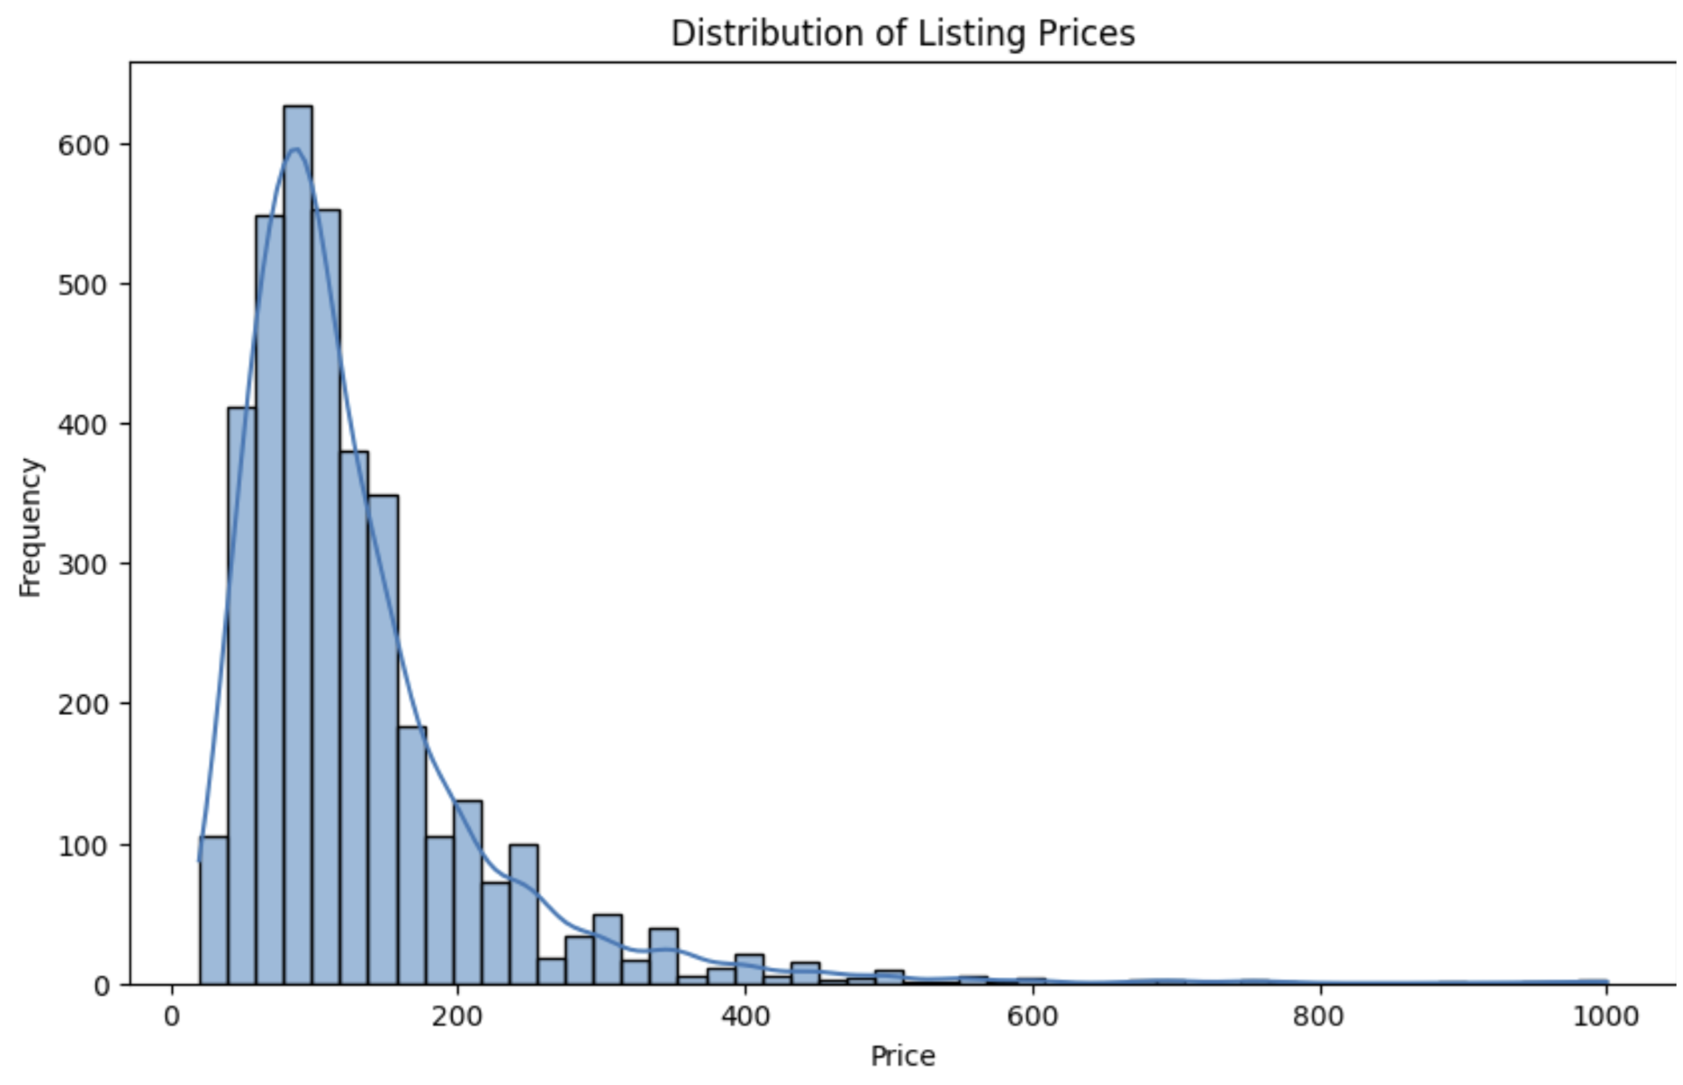
Exploratory Data Analysis (EDA)

Slide 7
Business Questions
Q: How do the number of reviews and review scores impact the price of a listing?
The random forest model found an MSE of 8369.73 , RMSE of 91.48 and R2 of -0.38%.
An analysis to predict listing prices using a random forest model.
Key steps :
selecting relevant parameters like beds, bedrooms, and property type
splitting the dataset into training and test sets.
Evaluate the test result
MSE of 8369.73
RMSE of 91.48
R2 -0.38%
Result : Indicating poor model performance. This suggests the model isn't effectively capturing price variability. To improve, consider revisiting feature selection, adjusting model parameters, and exploring alternative modeling techniques.

Slide 8
Business Questions
Q: Predict the future prices of listings based on historical data and identified trends?
Focused on the accuracy of using historical information from the zip code, accommodates, bathrooms, bedrooms, and beds columns to predict price.
Dataset was split into two by features and the target variable.
70% training and 30% test.
Result :
Mean Squared Error (MSE): The model achieved an MSE of 4312.98, indicating the average squared difference between predicted and actual prices.
Root Mean Squared Error (RMSE): RMSE was 65.67, providing the average magnitude of prediction errors in the same unit as the target variable (price).
R-squared (R2): The R-squared value was 0.4827, meaning the model explains 48.27% of the variance in the price data. This suggests a moderate fit where the model reasonably captures the variability in prices based on the selected features.

Slide 9
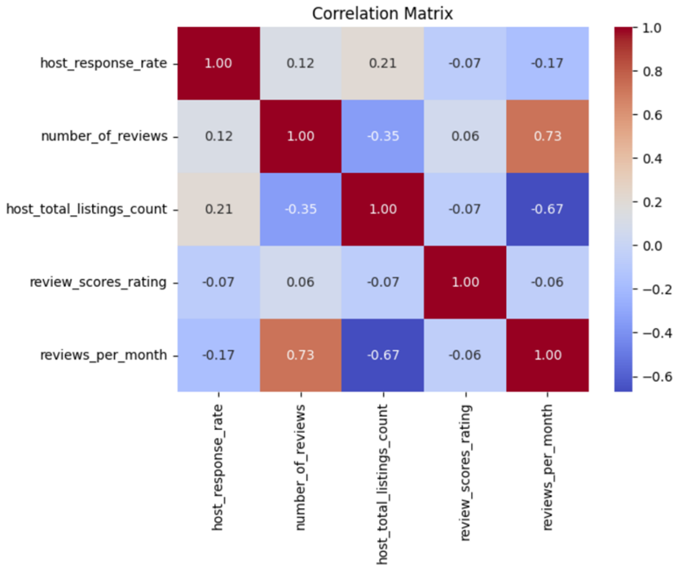
Business Questions
Q: Is there a correlation between host response rate and the multitude of review type categories?
Negative correlation between reviews per month and host total listings
Suggesting hosts with fewer reviews may manage more listings
This challenges the assumption that more reviews lead to higher income and more listings.
This correlation could reflect differences in listing affordability and customer base size.

Slide 10
Conclusion
The findings within this project expose a promising yet challenging landscape for predictive modeling in the marketing industries.
While the models provided insights and ways to measure success, forecasting listing prices proved difficult due to economic unpredictability.
There is a need for continuous model refinement and data-driven decision-making. Also, it has accountability to ensure affordability for all, particularly lower-income families.

Slide 11
Thank you for watching!
Q&A

